Slide 1




Ulster GAA
Trustee update Effective Dec 2025
Tyrone County Committee
02/09/2025

Slide 2
National changes to the Trustee system
All Provincial individual Trustees will retire on 31/12/2025
All Provinces and Counties will nominate the Corporate Trustee.
What do we have to do as clubs?
Check with the club solicitor who the Trustees are.
If you have already adopted the Corporate Trustee, option 1 or 2, No action required.
If you have 5 individual named Trustees (people), Action is required!
ULSTER GAA Trustee update

Slide 3
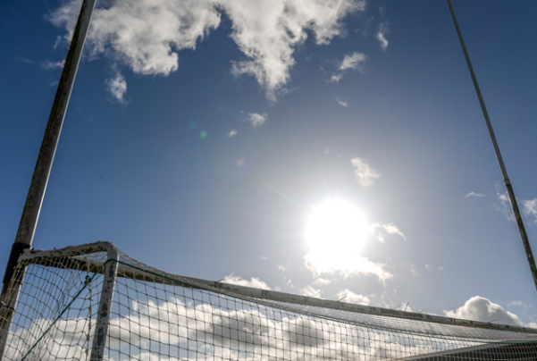
ULSTER GAA TRUSTEES
CLG Finance Department resources.
Code of Trust.
Information & Steps to follow to update the Trustees.
Trustee update legal pack to be shared with the club solicitor. Contains templates and instructions.
Trustee options.
Option 1:
3 local Trustees & Corporate Trustee.
Option 2:
Corporate Trustee only.

Slide 4
ULSTER GAA TRUSTEES
Step by step process
Executive Committee nominate the Corporate Trustee either with local Trustees or alone.
Inform the current club Trustees.
Hold an AGM / EGM to have the change approved by the club membership.
Appoint a solicitor to draft the necessary transfer documents.
All Trustees will execute the documents.
The solicitor will register the transfer with Land Registry.
Claim the grant for Option 2 if applicable.

Slide 5
ULSTER GAA TRUSTEES
Questions?

Slide 6


THANK YOU
Paul Sanders
paul.sanders.ulster@gaa.ie
0044 7884 032843
ulster.gaa.ie

